Slide 1

PhishGuard AI Sentinel ++
Subtitle: AI-Powered Contextual Phishing & Social Engineering Defense
Event: CloudSEK AI in Cybersecurity Hackathon
Team: AI BOTS

Slide 2


The Problem: Sophisticated Threats Evade Defenses
Personalized Attacks
Zero-Day Threats
AI-generated phishing bypasses keyword and signature filters.
Undetected new attacks cause significant breaches and losses.
Alert Fatigue
Too many false alarms exhaust analysts and reduce focus.

Slide 3
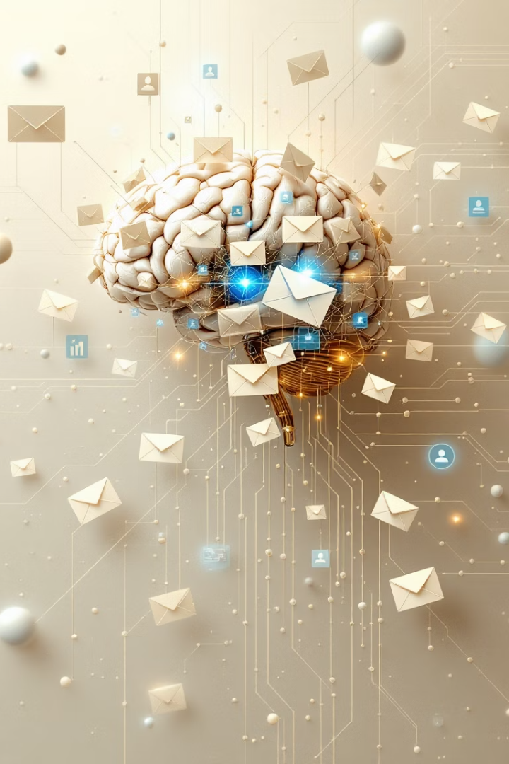
Our Solution: PhishGuard AI Sentinel ++
Deep Contextual Analysis
Explainable AI Alerts
Clear risk scores with reasons behind each alert.
Powered by Google Gemini for intent, tactics, and language insight.
Tuned Accuracy
Minimizes false positives on legitimate business emails.

Slide 4
Key Features & Analysis Layers
Content Analysis
Header Checks
URL Evaluation
Attachment Flags
AI detects deceptive language, psychological tactics, urgency, and intent.
Validates sender consistency and email authentication (SPF/DKIM/DMARC).
Hybrid model: blocklists and AI risk simulation with reputation tuning.
Identifies suspicious filenames and risky extensions (no sandbox yet).

Slide 5
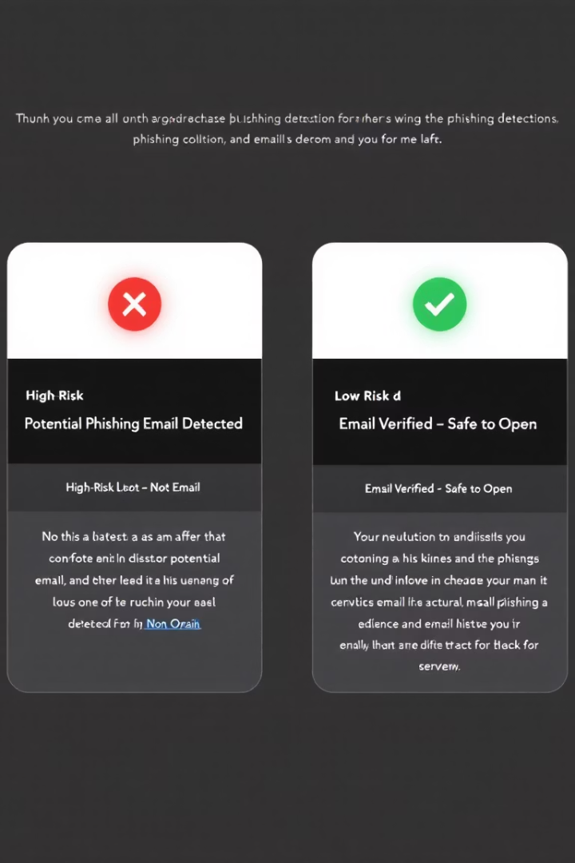


Demo: PhishGuard AI++ in Action (Screenshots)
High-Risk Alert
Raw email source input detects From/Sender mismatch
AI flags credential harvesting intent
High URL risk score & red alert
Low-Risk Alert
Manual mode on Google Docs share email
Low risk score and green information icon
Clear explanation: "Likely Safe"

Slide 6
Tech Stack & Architecture
AI Backend
Platform
Key Libraries
Architecture Flow
Google Gemini API (gemini-1.5-flash) via Python SDK
Python 3.9+ backend and Streamlit UI frontend
google-generativeai
UI (app.py) → Core Analyzer → Helpers (gemini_handler, utils, basic_checks)
pandas
regex
email parsing

Slide 7

Impact & Future Scope
Risk Reduction
User Empowerment
Captures sophisticated threats missed by basic filters.
Explainable insights reduce alert fatigue and speed triage.
Future Features
Direct email integration (Gmail, M365)
Real-time CTI feeds and sandboxing
User feedback for continuous tuning

Slide 8

Conclusion & Thank You
PhishGuard AI Sentinel ++ delivers intelligent, explainable phishing defense.
Combining AI context analysis, tuned accuracy, and clear explanations.
Team: AI BOTS
Call to Action: Questions? Thank you for your attention!

